Slide 1




Building interactive web apps using R Shiny
C. Edson Utazi
October 2026

Slide 2
Learning objectives
By the end of this session, you will be able to:
Explain the utility of Shiny for interactive visualizations.
Describe the UI–server architecture of a Shiny application and explain the roles of its key components.
Develop and run a simple Shiny application.
Run and publish a Shiny web app using outputs from a spatial (or spatiotemoral) analysis.
Introduction to R Shiny

Slide 3
What is Shiny?
Shiny is an R package for building interactive web applications.
Users interact with controls in a browser; R performs the calculations and sends updated results back.
Shiny apps facilitate user interaction through a functionality called reactivity.
You can build substantial applications without writing JavaScript, HTML or CSS directly (although these allow greater flexibility and customization).
Typical applications: dashboards, data exploration tools, analytical interfaces, reporting tools and decision-support applications.
Shiny is particularly useful when the underlying analysis is already written in R.
Useful resources: Tutorials on Shiny website (beginners)
Shiny gallery (more advanced)
shinyapps.io - fully managed cloud service by Posit

Slide 4
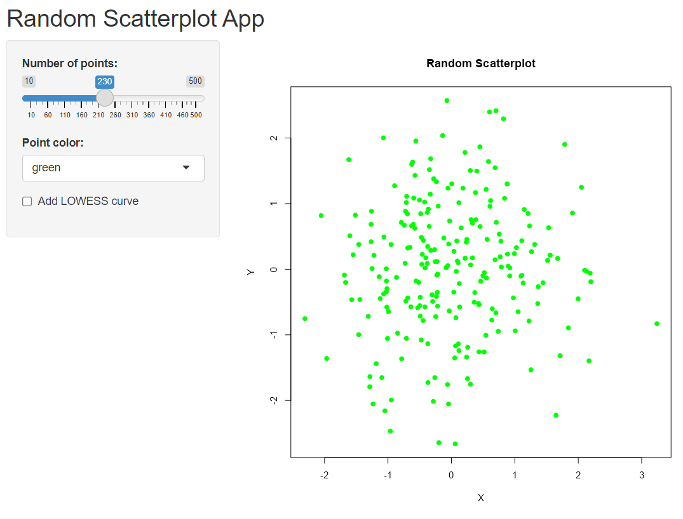
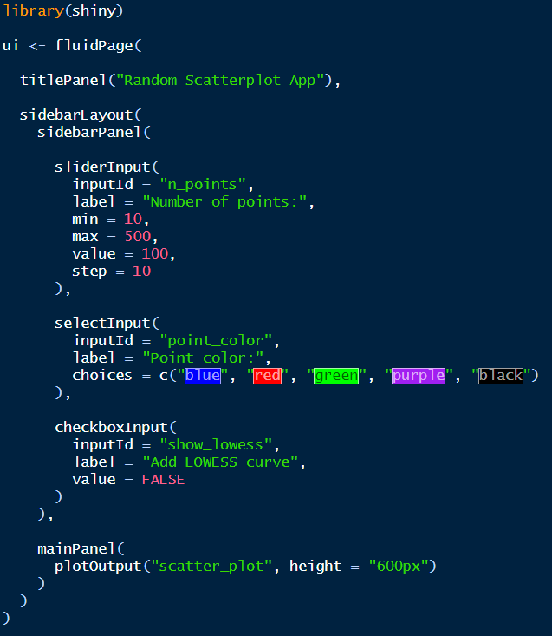
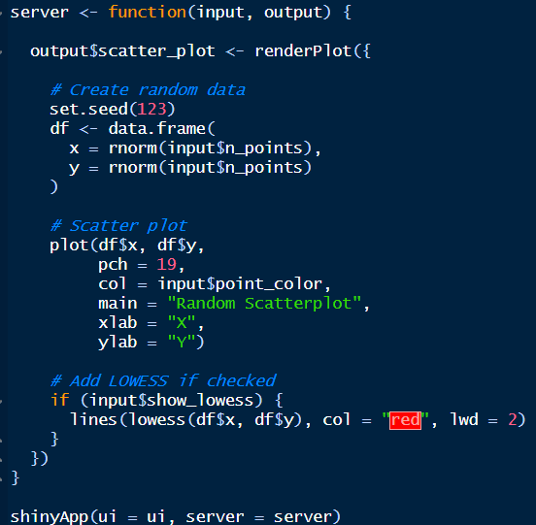
Shiny App Example 1

Slide 5
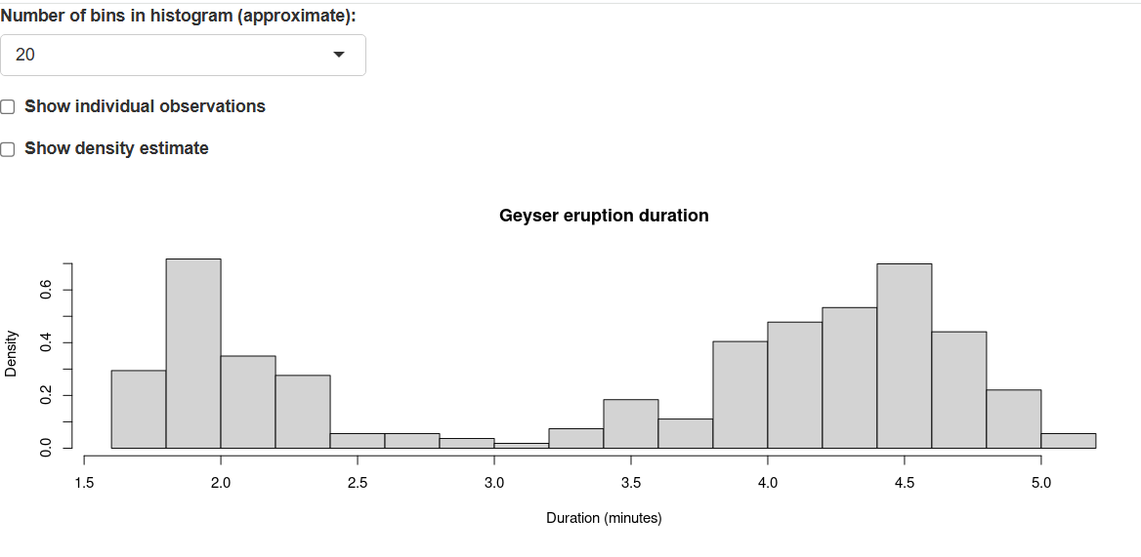
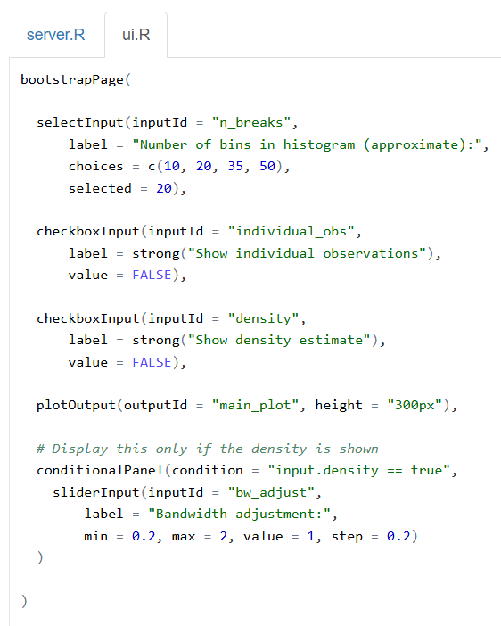
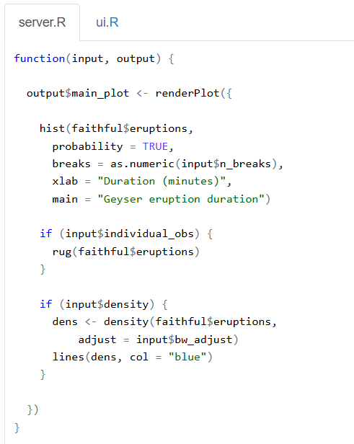
Shiny App Example 2
Source: https://shiny.posit.co/r/gallery/

Slide 6
The basic Shiny structure
#Load the package
library(shiny)
# define user interface object
ui <- fluidPage()
# define server function
server <- function(input, output) { }
# call to shinyApp()
shinyApp(ui = ui, server = server)
An R code to build a Shiny app usually contains three components:
a user interface object (ui)
a server function (server())
A call to the shiny app function (shinyApp()) which creates the app from the user interface/server pair
User interface (UI)
Server
Defines what the user sees
Controls layout and appearance
Contains inputs and output placeholders
Example: sliderInput(), selectInput(), plotOutput()
Contains the R code that responds to inputs
Calculates results
Creates outputs using render*() functions
Example: renderPlot(), renderText(), renderTable()

Slide 7
The basic Shiny structure
Note that a Shiny app can live in its own directory with app.R as the main script. The directory can contain data and other R scripts needed by the app.
A Shiny app can also be created by writing two separate R scripts ui.R and server.R for the user interface and server functions, respectively. We can then create the app by calling runApp(“path-to-directory”), where path-to-directory is the directory where both functions and other supporting files are saved.

Slide 8
Shiny App Example 3
ui <- page_sidebar(
title = "Hello Shiny!",
sidebar = sidebar(
sliderInput(
inputId = "bins",
label = "Number of bins:",
min = 1,
max = 50,
value = 30)),
plotOutput(outputId = "distPlot")
)
server <- function(input, output) {
output$distPlot <- renderPlot({
x <- faithful$waiting
bins <- seq(
min(x), max(x),
length.out = input$bins + 1)
hist(x, breaks = bins,
border = "white",
xlab = "Waiting time (minutes)",
main = "Histogram of waiting times")})
}
Posit’s built-in Hello Shiny example uses the faithful dataset.
The user controls the number of histogram bins with a slider.
Changing the slider causes the histogram to update automatically.
Run the example directly with:
library(shiny)
runExample("01_hello")

Slide 9
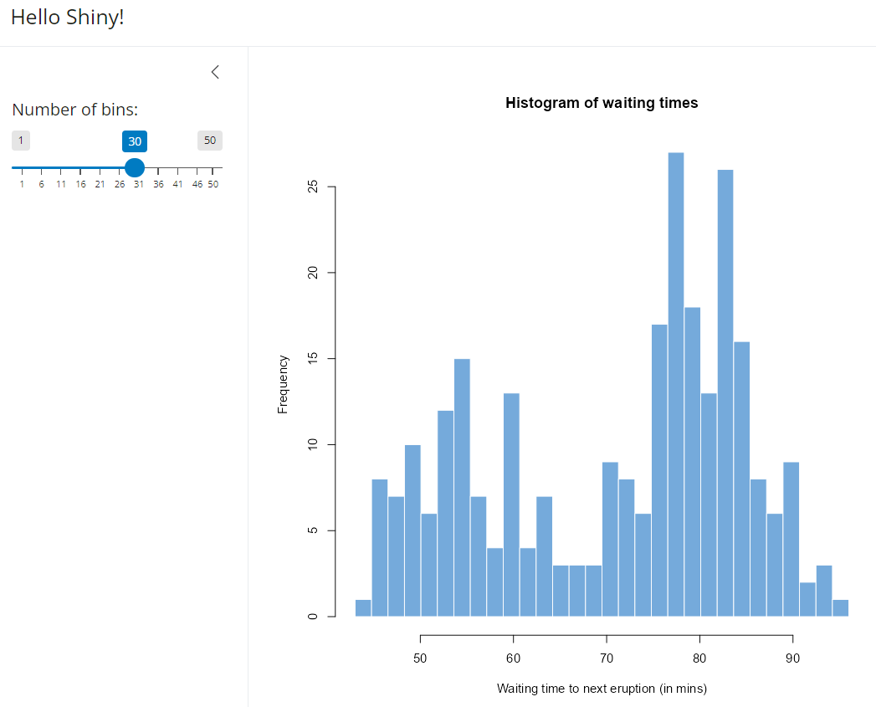
Shiny App Example 3

Slide 10
How reactivity works
Shiny tracks dependencies between inputs, calculations and outputs through a mechanism known as reactivity.
This allows the app to automatically respond to changes in inputs or other reactive values.
In Example 3, when input$bins changes, Shiny knows that distPlot depends on it.
- The renderPlot() expression is re-executed.
- The browser receives the updated plot.
input$bins
↓
renderPlot({ ... input$bins ... })
↓
output$distPlot
This is the central idea behind Shiny: change an input → update dependent outputs.

Slide 11
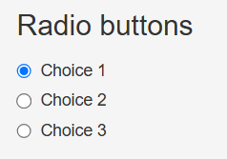
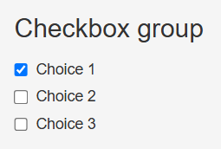
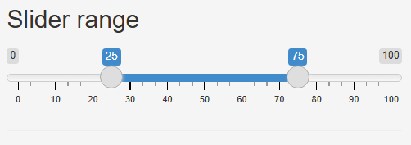
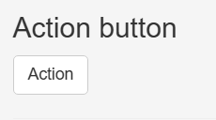
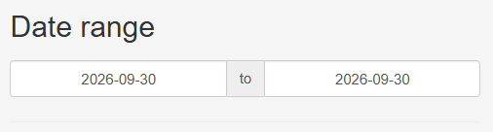
Inputs
Inputs are web elements that users can interact with by modifying their values
Changing the value of an input automatically updates other elements of the app that depend on it
In Example 1, the inputs include:
  a numeric input that allows the user to select the number of bins to include in the histogram
  checkboxes that allows the user to show individual observations or density estimates
Inputs for Shiny apps can include texts, numbers and dates.
An input can be added to a Shiny app by placing an input function within the ui function
Common input functions
sliderInput() — numeric slider
selectInput() — drop-down selection
textInput() — text entry
checkboxInput() — TRUE/FALSE
actionButton() — trigger an action
See more examples here

Slide 12
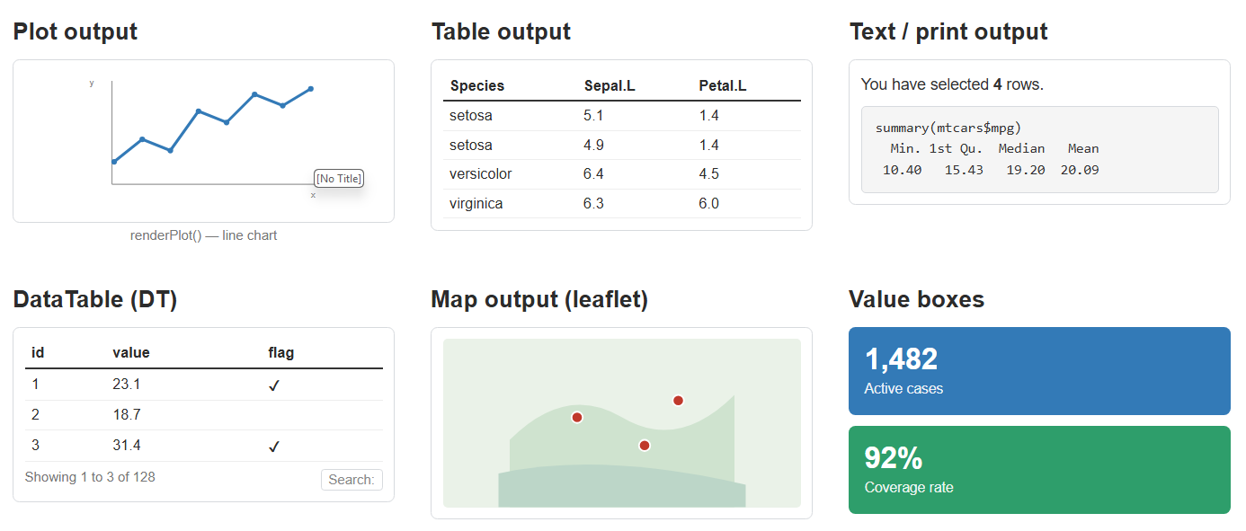
Outputs
Shiny output functions turn R objects into outputs in the user interface
Shiny apps can include a variety of output elements such as plots, images, tables and HTML widgets
(HTML widgets are interactive web-based visualizations created in R using packages such as leaflet and plotly. They provide an R interface to JavaScript visualization libraries and can be embedded in R Markdown documents, Shiny applications, etc. HTML widgets are included in Shiny using the htmlwidgets package.)
Output functions are part of the ui, while the corresponding render functions are included in the server() function
Common Shiny output functions
UI output function | Server render function | Purpose
textOutput() | renderText() | Display text
verbatimTextOutput() | renderPrint() | Display printed R output
plotOutput() | renderPlot() | Display a plot
tableOutput() | renderTable() | Display a table
dataTableOutput() | renderDataTable() | Interactive data table
uiOutput() | renderUI() | Dynamically generate UI elements
htmlOutput() | renderUI() | Display dynamically generated HTML
imageOutput() | renderImage() | Display an image
render*() functions make server calculations reactive and connect them to outputs

Slide 13
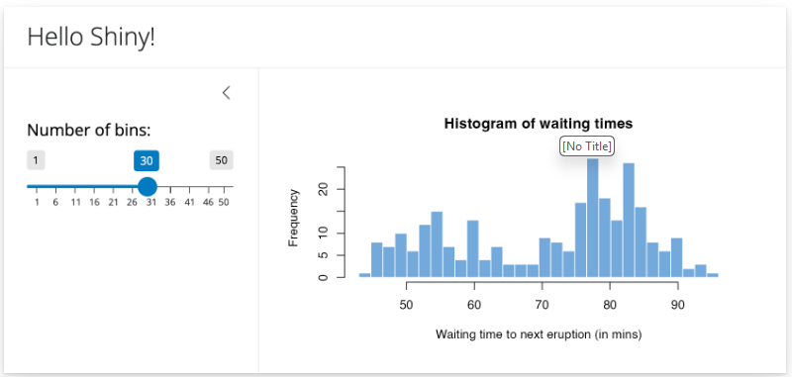
Layouts
The layout of the user interface of a Shiny app can be created in different ways
Multiple examples can be found on the Shiny website
Here, we show an example using the sidebar layout which provides a sidebar for inputs and a bigger main area for output
R code:
ui <- page_sidebar(
title = "Hello Shiny!",
sidebar = sidebar(
sliderInput( "bins", label = "Number of bins:", min = 1, value = 30, max = 50
)
),
plotOutput("distPlot")
)
Source: https://shiny.posit.co/r/articles/build/layout-guide/
Introduction to R Shiny

Slide 14
Step-by-step guide on how to create and publish a Shiny app
Step 1: Create a shinyapps.io account
Go to https://www.shinyapps.io/
Click Sign Up now (The free plan allows up to 5 apps and 25 active hours per month)
Register – create an account using the registration options provided. You may be required to choose an account name. This can be a project name or any other name you find suitable.
After registration, log in to your shinyapps.io dashboard (use the login button at the top right corner of the page)
Step 2: Find your account name
Once logged in, you will have an account/dashboard associated with your shinyapps.io username.
You will need this when connecting R/RStudio to shinyapps.io.

Slide 15
Step-by-step guide on how to create and publish a Shiny app
Step 3: Install the rsconnect package in R
Open RStudio and run: install.packages("rsconnect")
rsconnect is the current R package used for deploying Shiny applications.
Then load the package: library(rsconnect)
Step 4: Connect RStudio to your shinyapps.io account
In RStudio: Go to Tools → Global Options → Publishing → Connect.
RStudio supports push-button publishing to shinyapps.io.
Select: shinyapps.io
RStudio will then open the shinyapps.io authorisation page.
Log in and authorise RStudio to connect to your account.
Once connected, RStudio will have the credentials required to publish your applications.

Slide 16
Step-by-step guide on how to create and publish a Shiny app
Step 5: Create your first two Shiny apps using the scripts provided
First copy the scripts into a new folder named shiny_app_scripts, possibly in the documents directory on your computer.
Open the scripts in R and run them one after the other to create the RShiny apps.
Click the RStudio button “Run App” to run each script.
You should see a Shiny application in a pop-up window.
Always make sure the application works locally before deploying it.
Step 6: Publish it to shinyapps.io
With the app script open in RStudio, look for the Publish button/icon in the RStudio interface, then click Publish.
Alternatively, if the app is running, the publishing icon is available in the Shiny application interface. Click Publish.
If there are many scripts in your folder, ensure that only the relevant script is selected when you want to publish.
RStudio will:
  package your application;
  identify the R packages it requires;
  upload the application to shinyapps.io;
  install the required packages on the server;
  start the application.
  The first deployment can take several minutes because the server has to recreate the application's R environment.

Slide 17
Step-by-step guide on how to create and publish a Shiny app
Step 7: Get the public URL
After successful deployment, shinyapps.io will give you a URL similar to: https://youraccount.shinyapps.io/my-first-shiny-app/
You can send this URL to someone else and they can run the application in their browser. They do not need R or RStudio installed.
Step 8: Publishing subsequent versions
Suppose you modify your Shiny script locally, you can test it by clicking Run App and then click Publish/Republish.

Slide 18
Step-by-step guide on how to create and publish a Shiny app
Step 9: Deploying from R
Once your shinyapps.io account is configured, you can deploy using:
library(rsconnect)
rsconnect::deployApp( appDir = "path/to/my_shiny_app" )
For example, if your application is in the folder “C:/Users/Edson/Documents/my_shiny_app”, you could use:
library(rsconnect)
rsconnect::deployApp( appDir = "C:/Users/Edson/Documents/my_shiny_app" )
deployApp() is the standard rsconnect function for deploying a Shiny application.

Slide 19
Additional resources
Posit — Shiny Basics, Lesson 1: Welcome to Shiny
Posit — Shiny Basics, Lesson 2: Build a user interface
Posit — Shiny Articles and documentation
Built-in examples: runExample("01_hello") through runExample("11_timer")
https://shiny.posit.co/r/getstarted/shiny-basics/

Slide 20
Exercise 8
The R scripts 1_shiny.R and 2_shiny.R are self-contained. Run these to familiarize yourself with the Shiny architecture.
Publish the apps and generate shareable links.
Run the script 0_workshop_spatial.R to create a Shiny app to visualize the outputs of a spatial analysis. The data required by the script are contained in the file “nga_dtp1_admin1.Rdata”. You can also publish the app if you wish.

